Slide 1




Prsented By:
Atharv kakade
Khushbu dhake
Ajinkya kolkar

Slide 2

Introduction
The ability of a computer to identify human handwritten digits from various sources, such as photographs, papers, touch screens, etc., And classify them into 10 predefined groups (0–9) is known as handwritten digit recognition system .
Our goal is to build an intelligent system that can accurately identity and classify handwritten digits from the popular mnist dataset.
We are using a powerful machine learning technique called convolutional neural networks (cnns).

Slide 3
Significance
Handwritten digit recognition system is used to recognize the digit which are written by hand.
A handwritten digit recognition system is also used to visualize artificial neural networks.
It is already widely used in the automatic processing of bank cheques , postal addresses, in mobile phones etc.

Slide 4

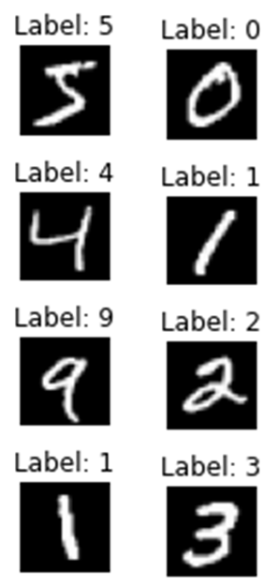
Data Description
The MNIST dataset is a widely used benchmark dataset in the field of machine learning and computer vision.
It consists of a collection of 28x28 pixel grayscale images of handwritten digits (0-9), along with their corresponding labels.
Mnist stands for modified national institute of standards and technology, where it was originally sourced from.
Dataset statistics:
Number of samples: 70,000
Number of classes: 10 (digits 0-9)
Training Images

Slide 5


Data preprocessing
Data preprocessing is the process of transforming raw data into a format that's better suitable for analysis and model training. it's the first step in creating a machine learning model.
Normalization
Normalization is a preprocessing technique that scales the values of features to a range between 0 and 1. This process is beneficial for improving the convergence of optimization algorithms and ensuring that different features have a similar scale.
Reshaping
.
Reshaping data refers to the process of changing the structure or dimensions of a dataset while preserving its underlying information. This transformation is often necessary to meet the requirements of specific algorithms or models, especially in the context of machine learning tasks.

Slide 6
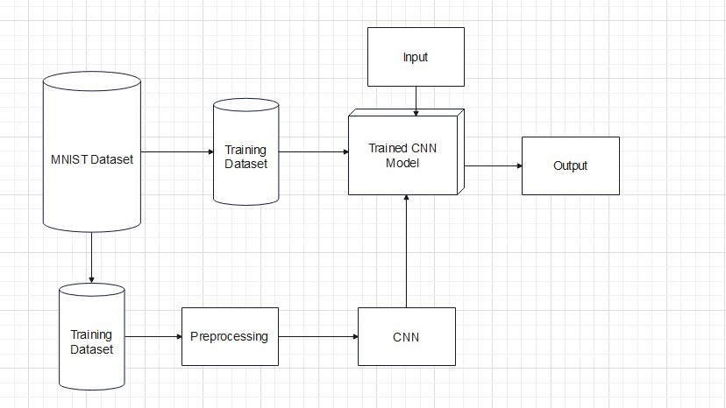
System Architecture

Slide 7
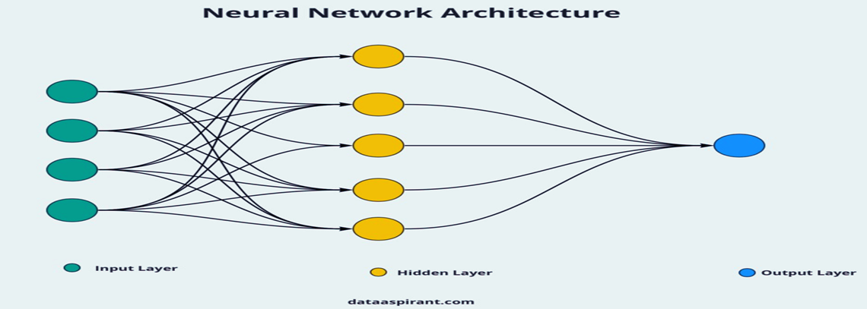
Neural Network
Neural networks are a class of machine learning models inspired by the structure and function of the human brain.
They consist of interconnected nodes, called neurons, organized in layers to process and learn from input data.

Slide 8

Machine Learning Algorithms
Convolutional neural networks (cnns)
Cnns are a type of deep learning model designed specifically for processing and analyzing visual data, such as images.
Convolutional neural network is a specific kind of neural network with multiple layers. it processes data that has a grid-like arrangement then extracts important features.
Cnn apply filters or kernels to input data in order to detect patterns or features within the data. These filters capture features such as edges, textures, and shapes. This characteristic makes CNNs particularly effective for tasks like object detection, image classification.

Slide 9
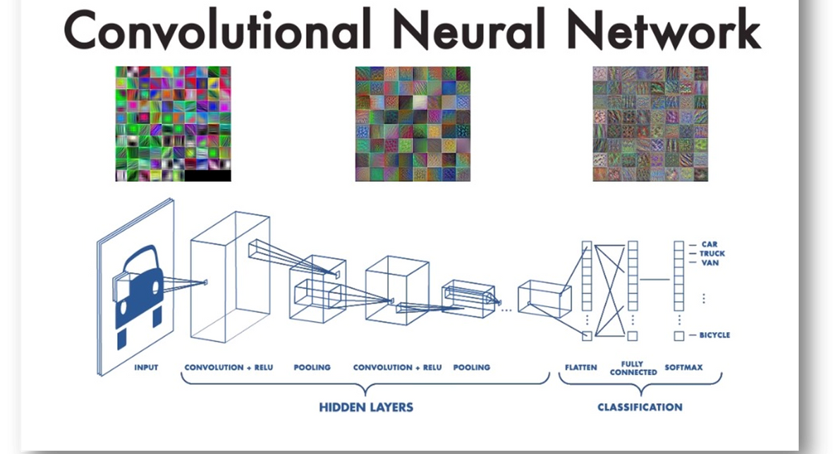
CNN Architecture

Slide 10



Components of CNN
Convolutional layer
Convolutional layers
apply learnable filters (also known as kernels) to input images, extracting local patterns and features.Each filter slides over the input image, performing element-wise multiplications and summing the results to produce feature maps.
Pooling layer
Pooling layers
downsample feature maps by summarizing small neighborhoods using operations like max pooling or average pooling. pooling helps reduce the spatial dimensions of the feature maps while retaining important information.
Activation function
Activation functions
introduce non- linearities into the network, allowing it to learn complex patterns in the data. common activation functions include relu (rectified linear unit), which is widely used in cnns.
Fully connected
Fully connected
layers process the output from convolutional and pooling layers and map it to the desired output space (e.g., class labels).These layers often follow the convolutional and pooling layers in the network architecture.

Slide 11
Performance Evaluation
Accuracy
Accuracy is a measure of the model's ability to correctly classify images. it represents the percentage of correctly classified images out of the total number of images. high accuracy indicates that the model is performing well in distinguishing between different classes. Accuracy of our model is 97%
Loss
Loss, also known as the cost or error, quantifies the difference between the predicted and actual labels. it is a key metric used to optimize the model during training by adjusting the model parameters to minimize the loss.
Loss of our model is 7%

Slide 12

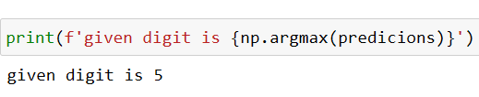
Screenshots
Input
Output

Slide 13


Real-World Applications
Postal services:
Sorting mail: handwritten digit recognition is used to automatically sort mail based on zip codes or addresses, improving efficiency in postal services.
Address verification: it helps in accurately reading and verifying handwritten addresses on envelopes or parcels.
Banking:
Check processing: handwritten digit recognition is employed to automatically read and process handwritten numbers on checks, including the amount written in digits.
Atm deposits: it assists in recognizing handwritten digits on deposit slips or checks inserted into atms for cash deposits

Slide 14
Conclusion
In this study, we developed models based on deep learning and machine learning methods for handwritten digit recognition using mnist datasets.
Convolutional neural networks (cnns) are among the most fundamental classifiers, which explains why they perform more quickly than most algorithms
Cnns performed the best at recognizing handwritten digits. this leads us to the conclusion that cnn is the most effective solution for all types of prediction issues, including those using picture data.

Slide 15


Thank you....

